Slide 1
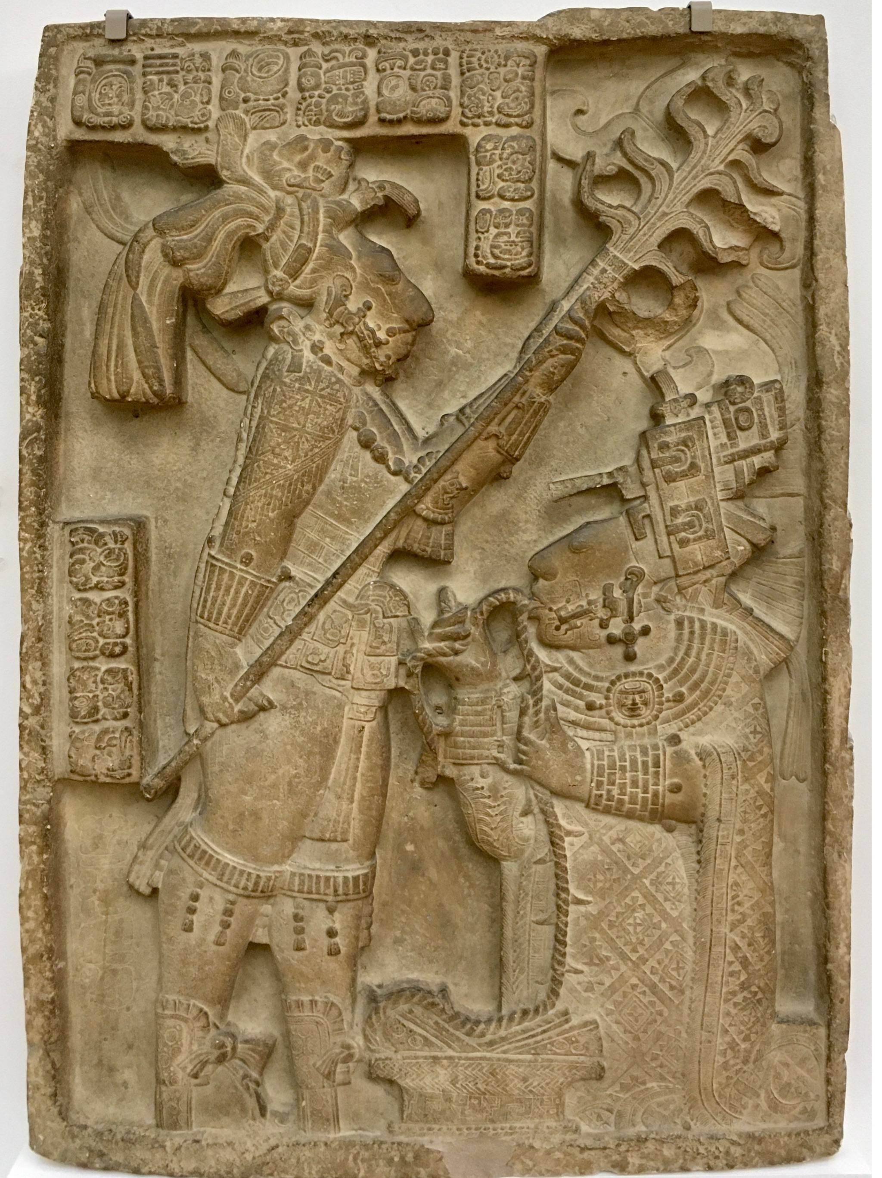
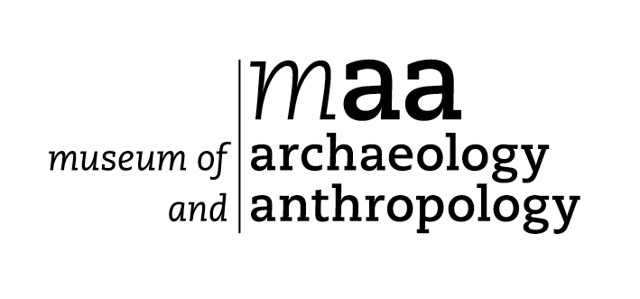
Ancient Maya
Rituals and Beliefs

Slide 2
Look carefully at the photo.
What do you see?
What are the figures wearing?
What are they doing?

Slide 3
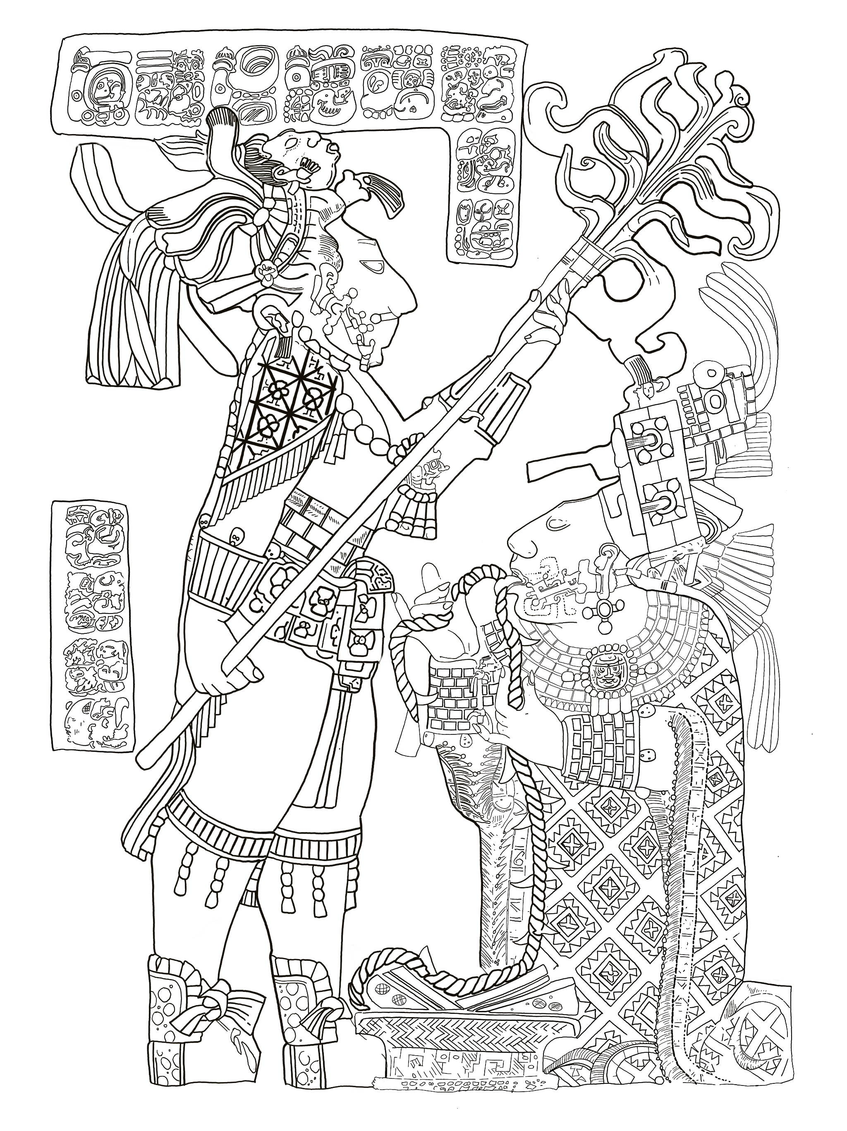
Turning the photo into a
drawing will help us to
see what’s going on.
Let’s look at each figure.
Use your worksheet.

Slide 4
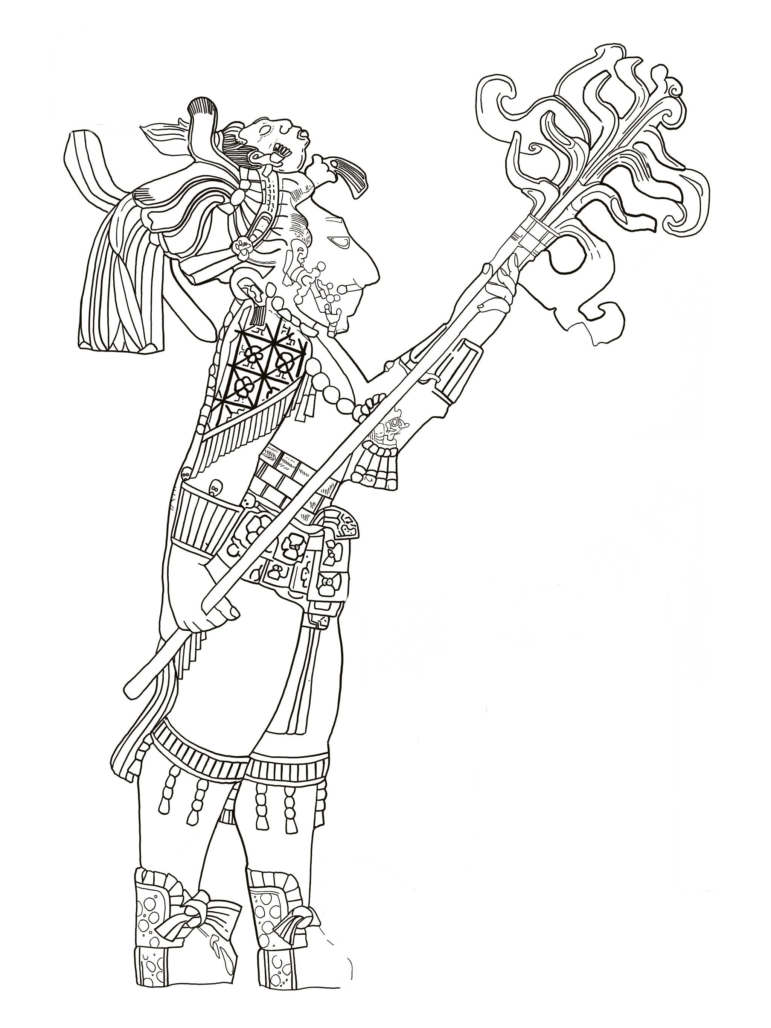
This is King Shield Jaguar II

Slide 5
This is King Shield Jaguar II
He holds a flaming torch.

Slide 6
King Shield Jaguar II
Flaming torch
He wears an elaborate headdress made from jade, shells, Quetzal feathers and a shrunken human head.

Slide 7
King Shield Jaguar II
Flaming torch
Elaborate headdress made from jade, shells,
Quetzal feathers and a shrunken human head
He wears a Sun god pendant.

Slide 8
King Shield Jaguar II
Flaming torch
Elaborate headdress made from jade, shells,
Quetzal feathers and a shrunken human head
Sun god pendant
and bands of precious jade.

Slide 9
King Shield Jaguar II
Flaming torch
Elaborate headdress made from jade, shells,
Quetzal feathers and a shrunken human head
Sun god pendant
Bands of precious jade
His sandals are made of Jaguar fur.

Slide 10
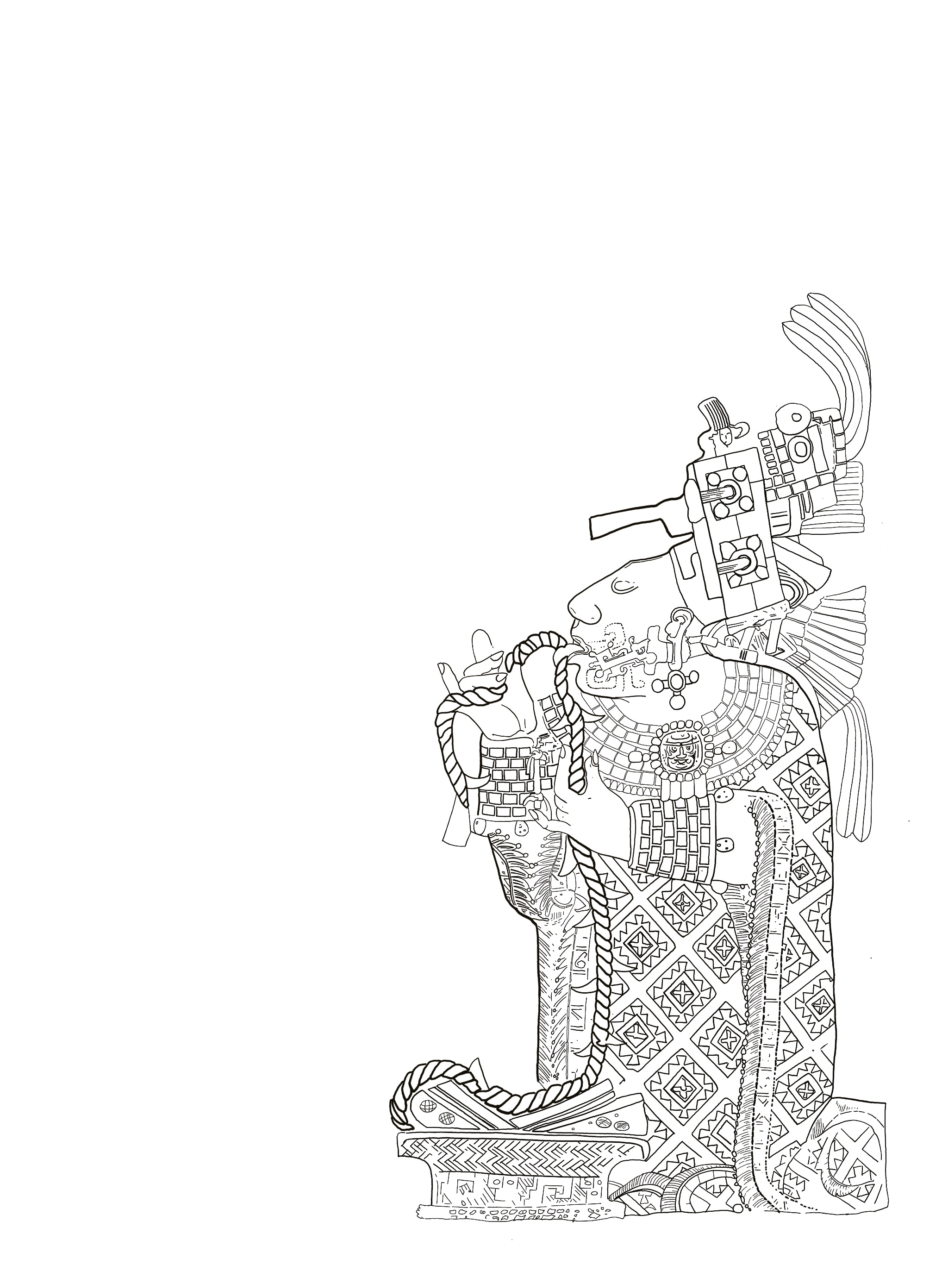
This is Lady K’ab’al Xook

Slide 11
This is Lady K’ab’al Xook
She also wears an elaborate headdress decorated with jade, shells and Quetzal feathers.

Slide 12
Lady K’ab’al Xook
Elaborate headdress decorated with jade, shells and Quetzal feathers
She also wears a Sun god pendent and a beautiful
necklace.

Slide 13
Lady K’ab’al Xook
Elaborate headdress decorated with jade and Quetzal feathers
Sun god pendent and beautiful necklace
and jade bracelets on her wrists.

Slide 14
Lady K’ab’al Xook
Elaborate headdress decorated with jade and Quetzal feathers
Sun god pendent and beautiful necklace
Jade bracelets
and a beautifully decorated cloak.

Slide 15
Do you think all ancient Mayans would have
worn elaborate headdresses, precious jewelry
and beautiful clothes?
DISCUSS

Slide 16
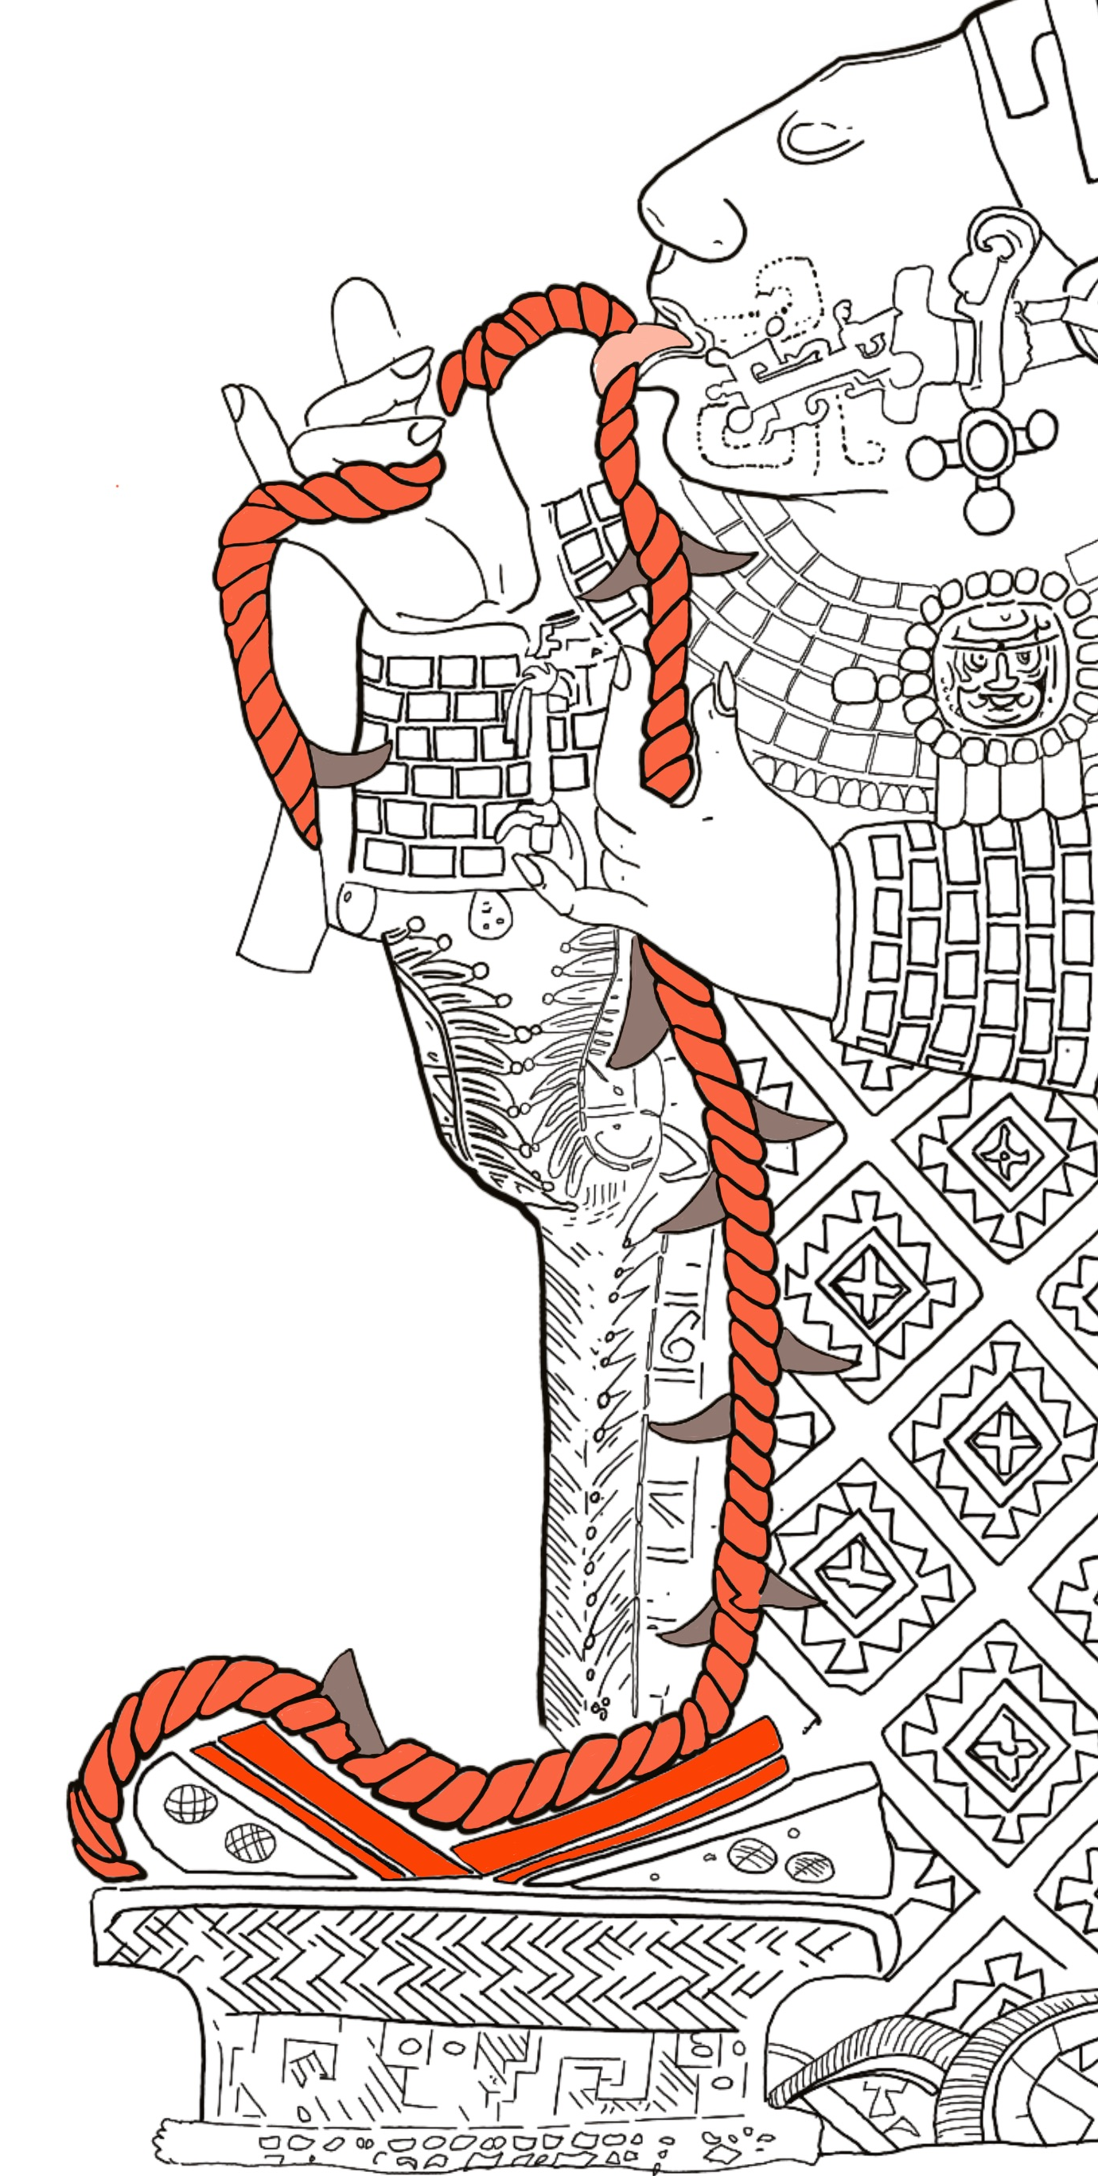
Ancient Mayan bloodletting ritual
All over the world people carry out rituals.
A ritual is when we do something in a particular way at a particular time.
It might include moving in a certain way, singing a song or using special objects.
Can you think of any rituals that you might do?

Slide 17
Ancient Mayan bloodletting ritual
Rope
Lady K’ab’al Xook pulls a rope of thorns or obsidian blades through her tongue.
The blood runs down the rope and soaks into bark paper inside the bowl.
The paper is then burnt and the rising smoke used by Lady K’ab’al Xook and King Shield Jaguar to predict the future.
Obsidian blades
or thorns
Bark paper
Bowl

Slide 18
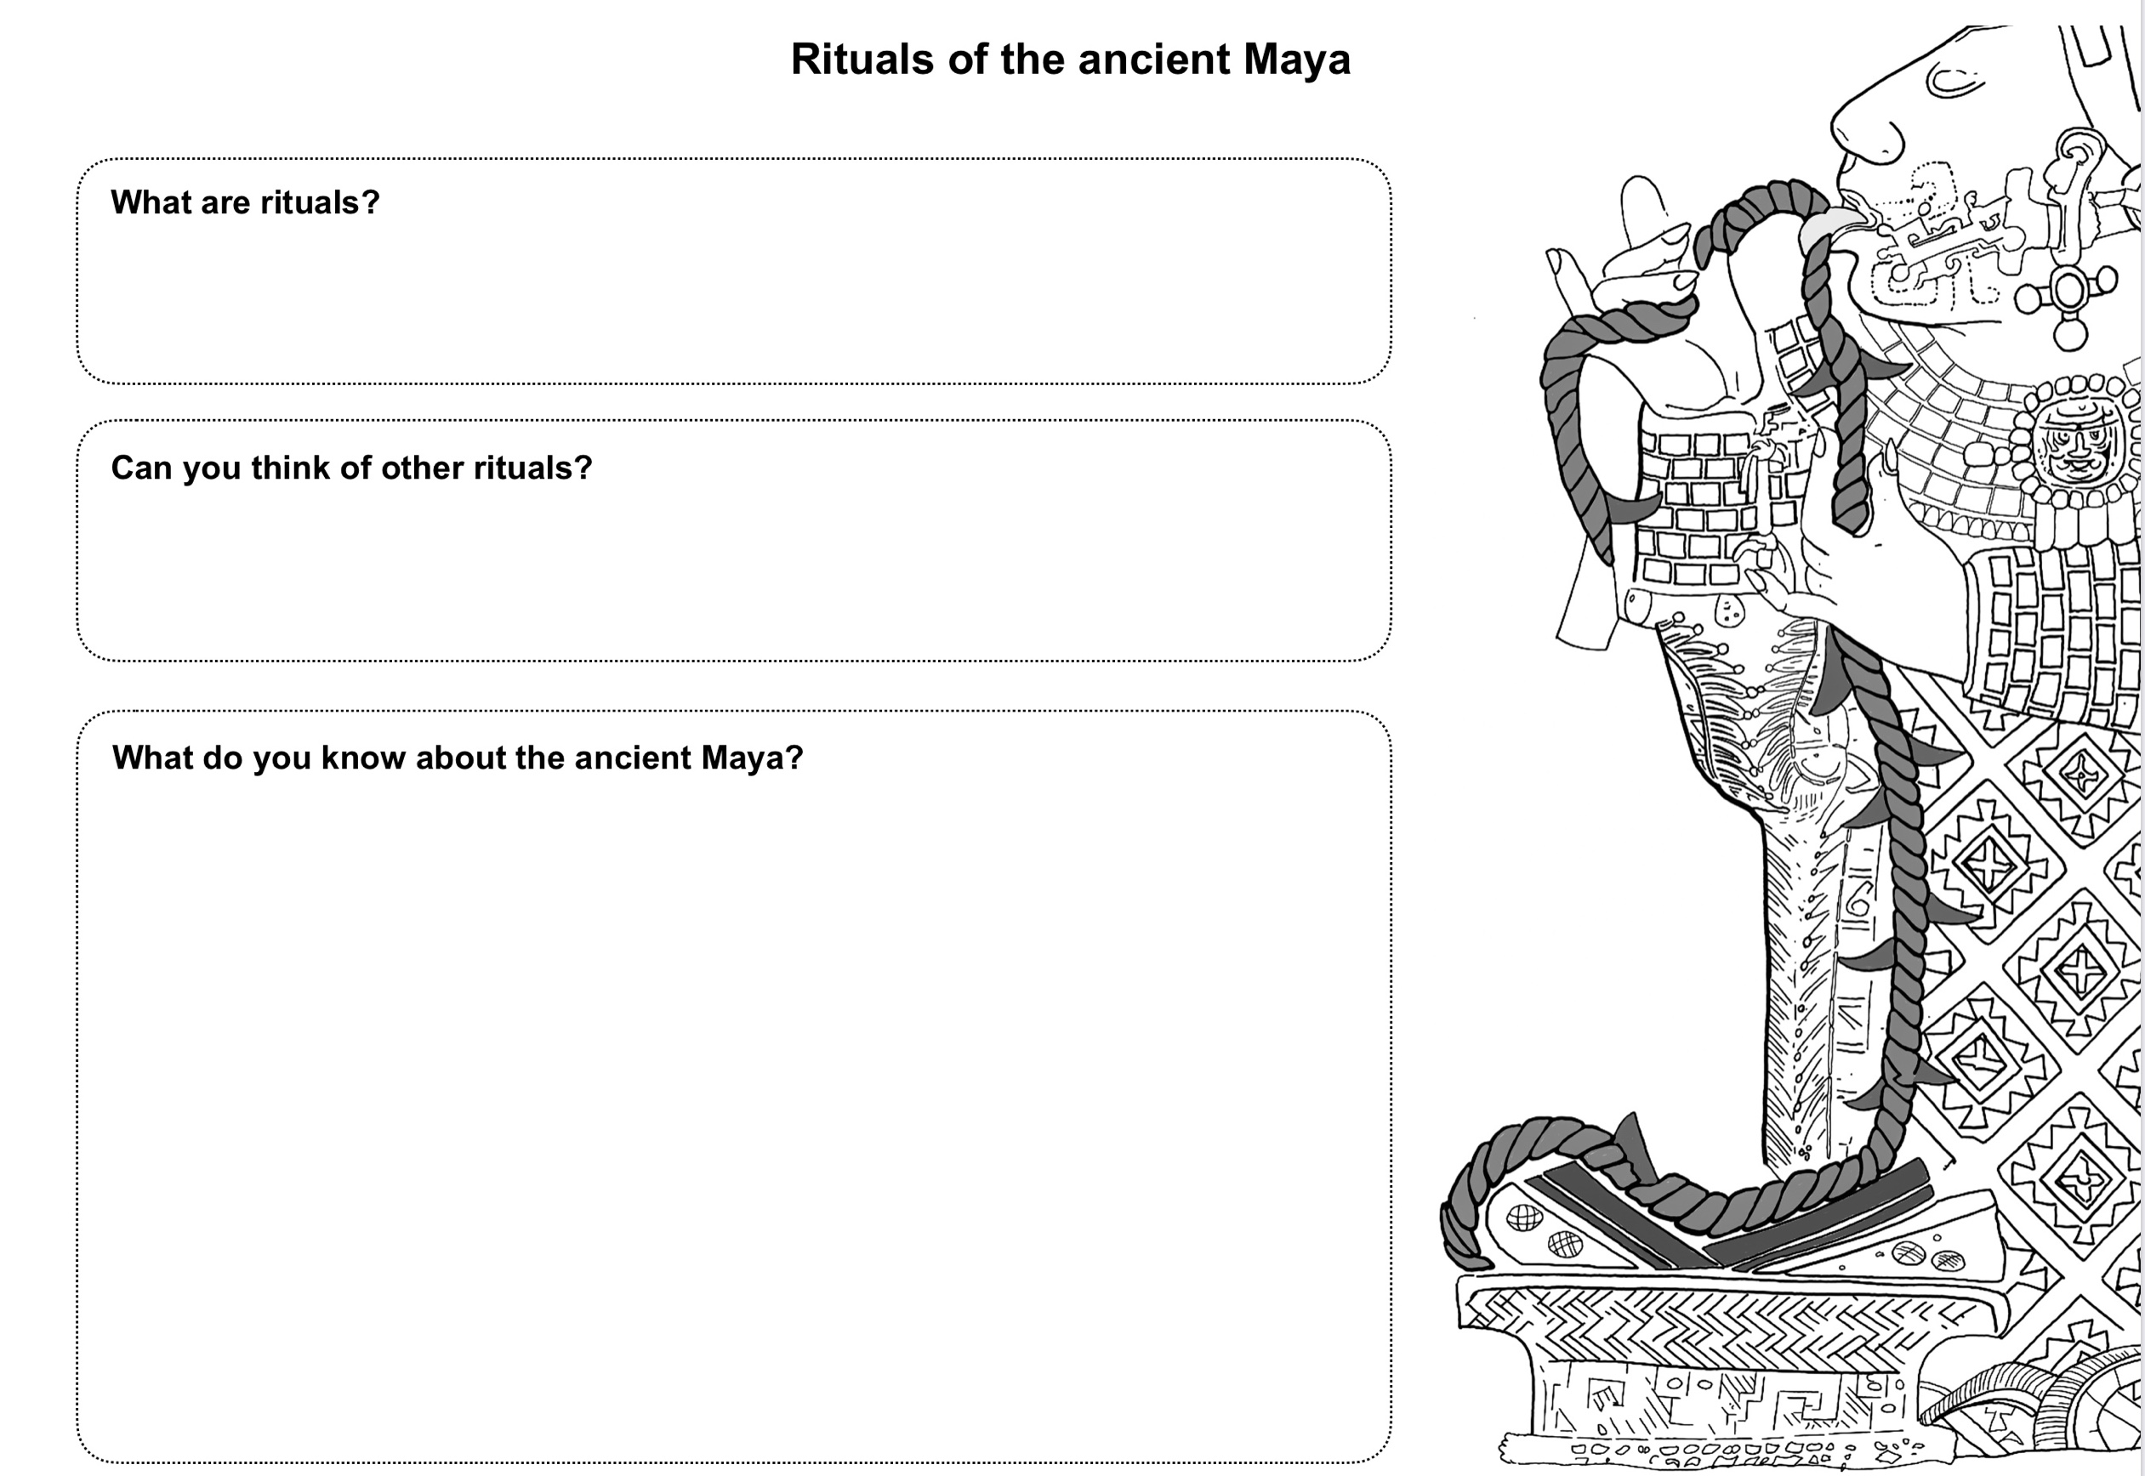
Complete your worksheet

