Slide 1
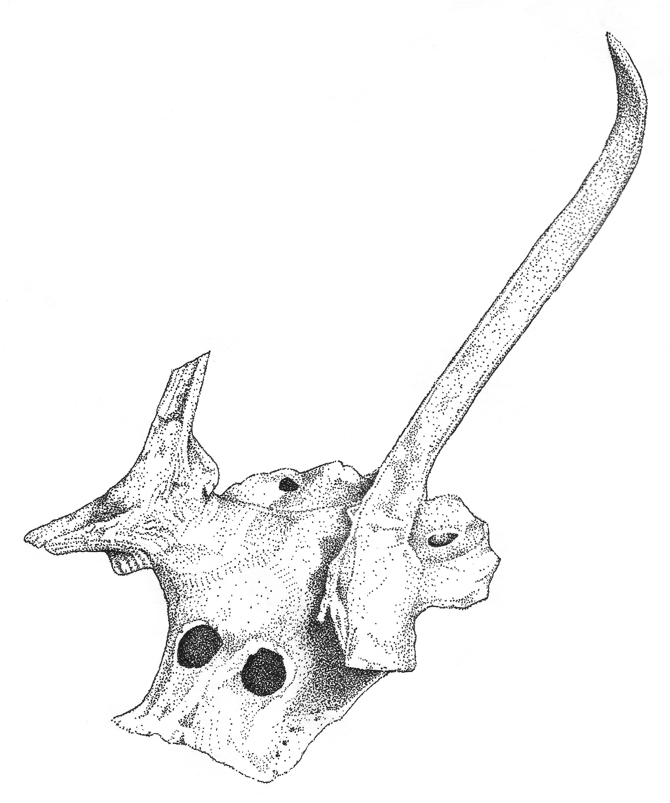

Mesolithic Antler Headdress
11,000 years old
from
Starr Carr, Yorkshire, England

Slide 2
Watch this video. It shows how Star Carr looked and sounded 11,000 years ago!
What was the environment like?
Can you spot a wild animal? Do you know what it is?
https://vimeo.com/66913559

Slide 3
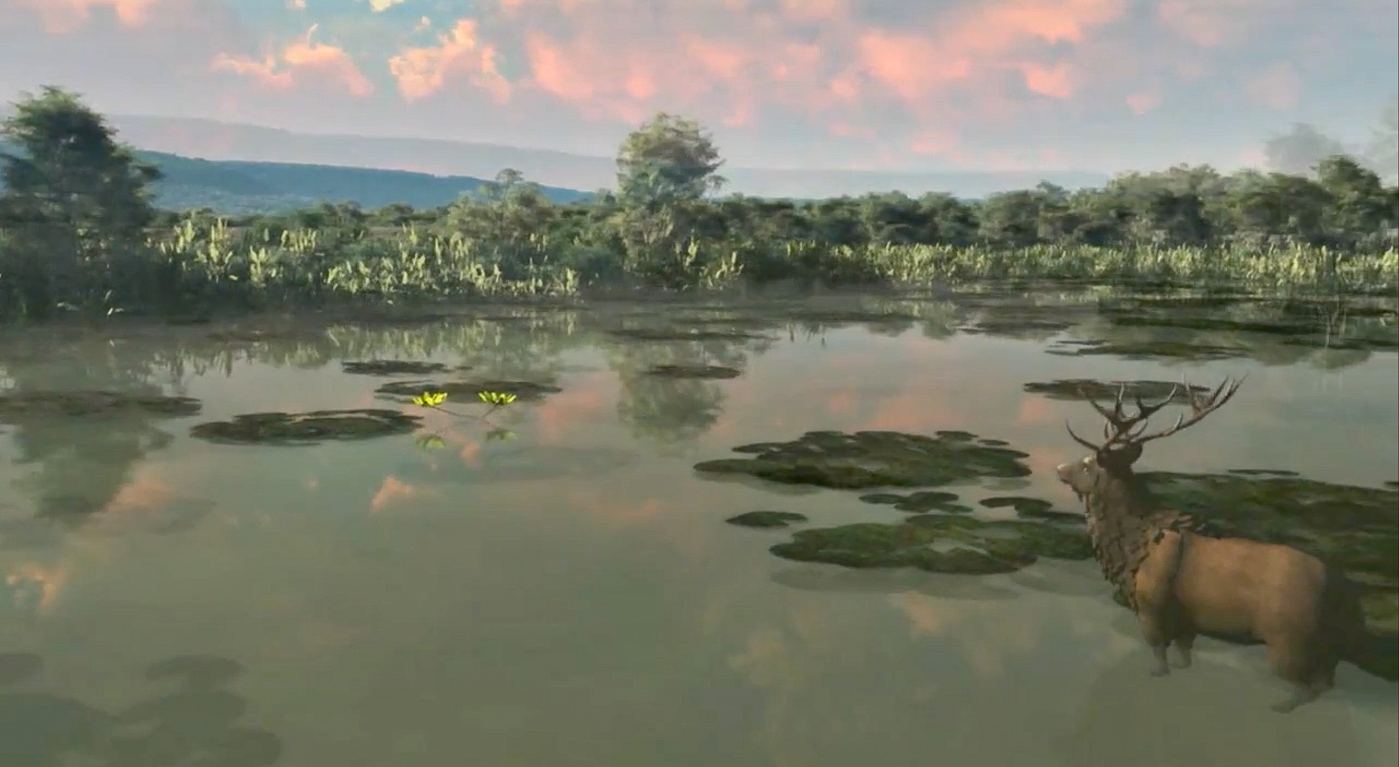

That’s right it was watery, and well done for spotting the Red Deer with its huge antlers!
Discuss why deer were important to Mesolithic hunter gatherers?

Slide 4
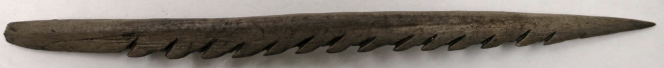
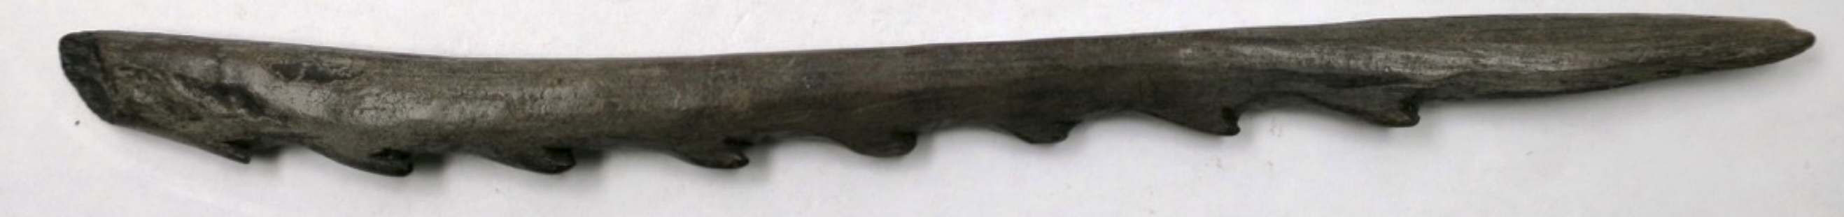
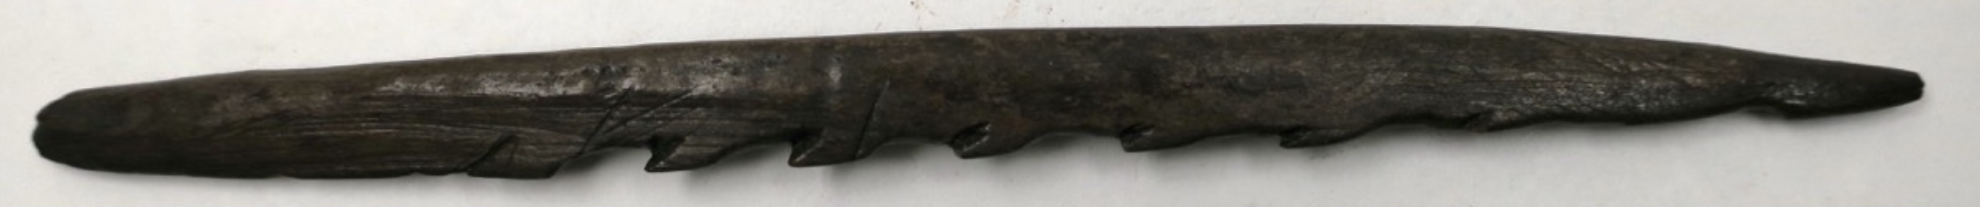
All these barbed points are made from Red Deer antler

Slide 5
All these barbed points are made from Red Deer antler
What do you think they were used for?

Slide 6
All these barbed points are made from Red Deer antler
What do you think they were used for?
What animals could they be used to kill?

Slide 7
All these barbed points are made from Red Deer antler
What do you think they were used for?
What animals could they be used to kill?
What other parts of a deer could be used by Mesolithic hunter gatherers?

Slide 8
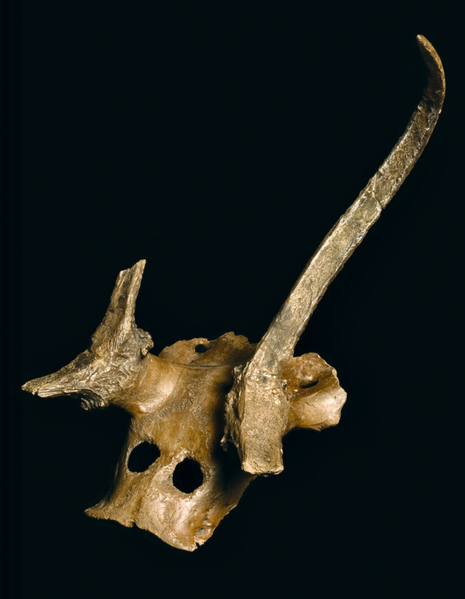
Which animal does this skull belong to?

Slide 9
Which animal does this skull belong to?
It’s from a Red Deer

Slide 10
Which animal does this skull belong to?
It’s from a Red Deer
What do you think it was used for?

Slide 11
Which animal does this skull belong to?
It’s from a Red Deer
What do you think it was used for?
We think it might have been worn by a hunter or a *shaman.

Slide 12
Which animal does this skull belong to?
It’s from a Red Deer
What do you think it was used for?
We think it might have been worn by a hunter or a *shaman.
*A shaman is a religious leader who can heal the sick.
They may have special powers and communicate with
human and animal spirits.

Slide 13
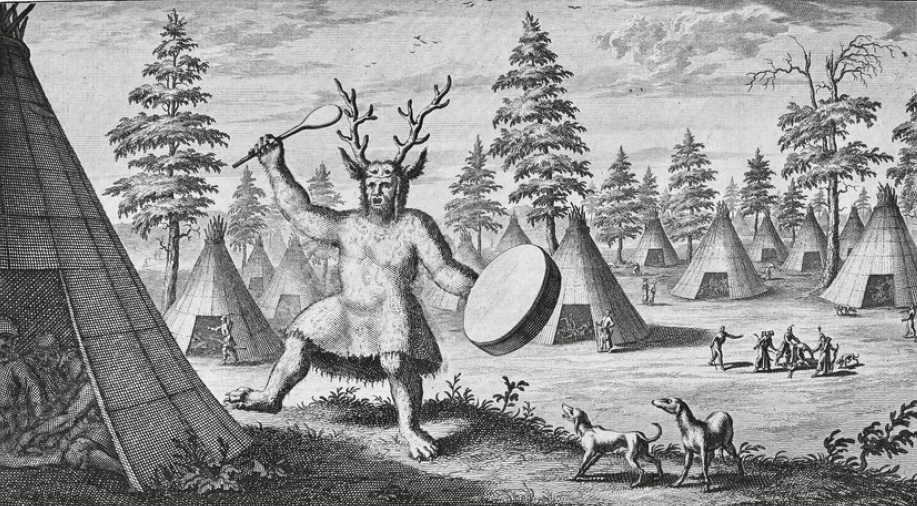
Here’s a very old drawing of a Siberian shaman wearing a similar antler headdress
Nicolaes Witsen, 17th century. Public Domain

Slide 14
SO
Hunters may have worn deer skins and antler headdresses to
help them catch their prey.
OR
Shaman may have worn headdresses to help them talk to animal
spirits or perform magical *rituals.
*A ritual is when something is always done the same way. For example, when it’s someone’s birthday,
we sing happy birthday to them and they blow out candles on a cake and make a wish.

Slide 15
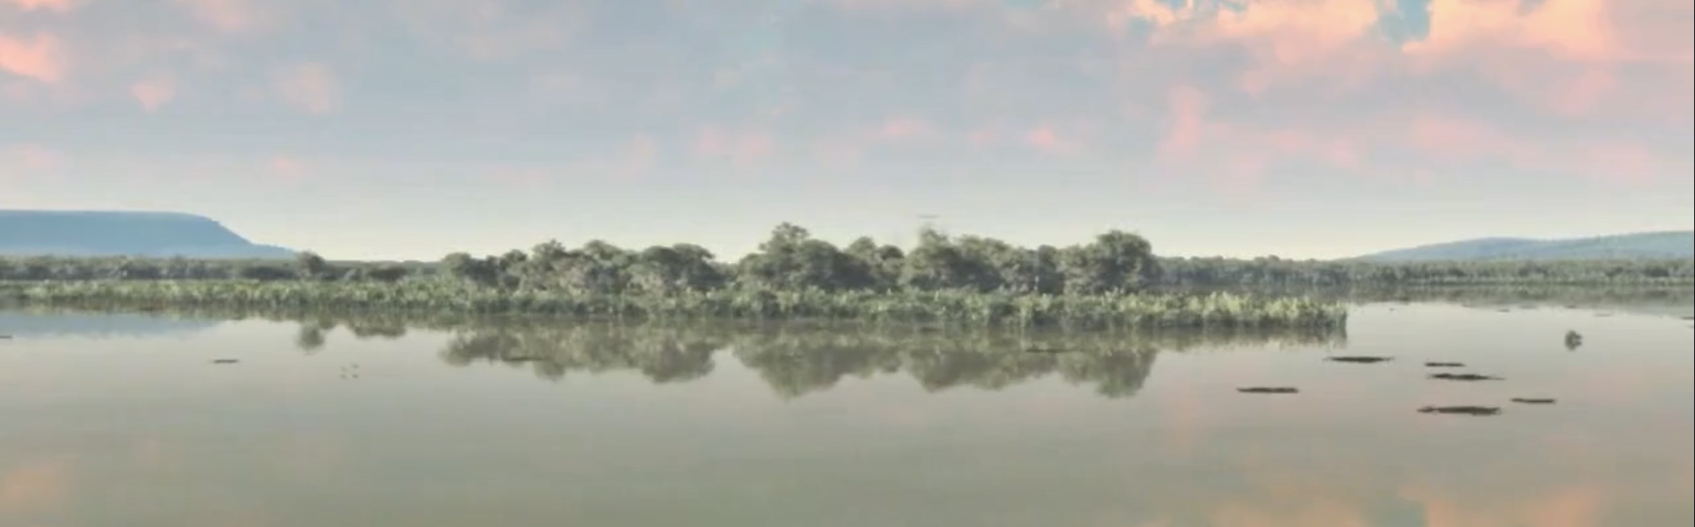
At some point, the headdresses were placed into the water at the edge of the lake or on
wooden platforms built across the lake.
Throughout prehistory, and even into Roman times, people placed objects into or near
water. Sometimes these objects would have been valuable possessions.
Why do you think people did this?

Slide 16
To be honest, we don’t really know why, but archaeologists have come up with some
possible explanations:
They were special gifts to the gods and spirits of the underworld
It was a way of making powerful or magical objects less powerful and less magical
What reasons did you come up with?

Slide 17
Additional resources
https://www.bbc.co.uk/bitesize/topics/z82hsbk/articles/z34djxs
http://www.starcarr.com/

